Slide 1
END-TO-END AUTOMATION • AGENT-DRIVEN
We set up a Revit model
without ever opening Revit or AutoCAD.
An AI agent owns the entire Planet Fitness project kickoff, from inbox to a fully configured, circuited, synced cloud model.
20-25 hr
<1 hr
4-5 hr
20+
manual setup, before
with supervised agent
saved per project
pre-built Revit ops

Slide 2






THE PIPELINE
Six stages, one agent.
Email Intake & Discovery
01
AutoCAD Processing (COM)
02
Cloud Infrastructure
03
Scans Outlook for legit kickoffs from Jack, Babafemi, Scott; filters follow-ups & noise
Extracts project name, downloads & renames DWGs (XO→X_BG, TB→X_TB)
Falls back to ACC folders when attachments are missing; checks what's already done
Opens DWGs, extracts title block + block coords + gridlines to CSV
Unlocks layers, deletes demo, rebases blocks 5×
AI block-rename detection scans every definition against its label, no hardcoded maps
Verifies speakers / fans / smoke detectors land on the correct MEP layers
Spins up Revit cloud models in ACC from template via APS API (2-legged OAuth)
Uploads DWGs + CSVs to the right ACC project folder
Opens cloud models via ExternalEvent for safe UI-thread execution
Revit Model Setup (MCP)
04
MEP Automation
05
Utilities & Toolkit
06
Links CAD background, greys layers across all views, centers scope boxes & equipment
Populates title block (name, address, project #, sq ft) + state-based cert numbers
Parses revisions, resets viewport positions, builds gridlines from CAD
Places Revit spaces from coord CSV with auto-tagging
Imports YAML equipment profiles into Revit ExtensibleStorage
Places every electrical fixture from CSV, auto-maps CAD blocks → YAML labels
Super Circuit V5: headless circuit assignment with overflow logic across panels
Syncs the workshared model to central
ACC bulk-check, MEP layer audit, standalone block-rename fixer
Pure COM extractors, no .dxex templates needed
AutoCAD COM toolkit w/ IMessageFilter, reconnect, progress-aware iteration
20+ pre-built Revit ops + color-splash QA + Crystallize → permanent pyRevit buttons

Slide 3


WHAT CHANGED
Manual checklist → one conversation.
4 to 5 hours saved in project setup alone
BEFORE
NOW
Est. 20 to 25 hours per project
Under 1 hour, supervised agent
Outlook, ACC, AutoCAD, Revit, pyRevit: five apps deep
Endless copy-paste between CSVs, sheets, and parameters
Manual block renames, layer audits, gridline rebuilds
Circuiting one panel at a time, by hand
Agent owns the inbox, ACC, CAD, the cloud, and Revit
AI catches block mismatches per-project, no static maps
Headless circuiting w/ overflow logic across panels
Human only confirms at checkpoints
The point: the agent doesn't just assist the workflow, it is the workflow.

Slide 4
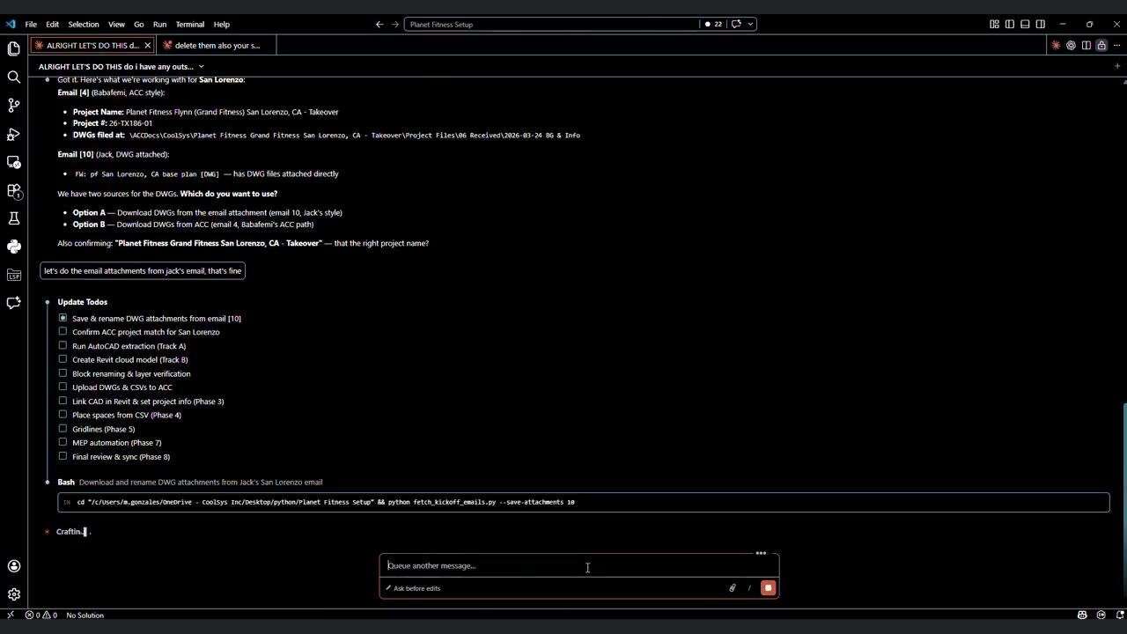
LIVE RUN
60 minute convo (condensed to 30 sec)
Click play. Full project kickoff start to finish, 26x speed, no human keystrokes inside Revit or AutoCAD.

Slide 5
PROFILE CAPTURE
Capture once, place forever.
Walk a real fixture in Revit; the panel records every linked child, parameter value, offset, and annotation as a YAML profile. The next project starts from that captured truth, not a blank slate.
Pick the parent
01
Encode offsets + params
02
Tags, keynotes, text
03
User selects an equipment parent (case, freezer, millwork, etc.). The agent walks every linked element via GetDependentElements and explicit picks; nothing else is guessed. Element_Linker JSON gets stamped on every captured element so audits can prove it back to its profile later.
Geometry is captured in the parent's local frame, so the whole assembly rotates as a rigid body when placed at a different orientation. Every parameter the user can edit on the live element is written into the YAML — including type-level params for keynote families (Keynote Value, Description).
Annotations travel with their host: family : type, world offset relative to the host fixture, leaders for tags, literal text content for text notes. On placement the annotation list rebuilds at the chosen location. Dedup compares against any tags / keynotes already on the new instance.
30+ profiles
0 hand re-modeling
captured for HEB and Planet Fitness so far
every linked element + annotation is captured automatically

Slide 6
PROFILE MANAGEMENT
YAML in, YAML out.
Profiles live in two places: a per-project Extensible Storage entity (so the data ships with the model) and an exportable YAML file (so the same templates seed every project that follows).
Manage Profiles editor
01
Extensible Storage v4
02
Import / export YAML
03
Tree view: linked sets, LEDs, annotations. The user edits parameter values, offsets, family : type, and merge-group truth-source pointers — every change round-trips cleanly through the YAML. Captured fields display + edit live; built-in keynote values surface alongside shared CKT_* params.
Project-local data lives on a dedicated DataStorage element (not ProjectInformation) so it survives schema changes and stays out of users' way. Four typed map fields (String / Bool / Int64 / Double) + DocGuid. Int64-first with Int32 fallback keeps Revit 2026 happy.
Output is byte-identical to what's stored — Import then Export is lossless. Same template can seed five projects with no copy/paste. Spaces config exports separately from equipment so a bakery template moves to the next store without carrying that store's space-to-bucket assignments.
1 source of truth
v100 schema
edits in the YAML propagate to every project on next import
with v3 / v4 legacy migration on import

Slide 7
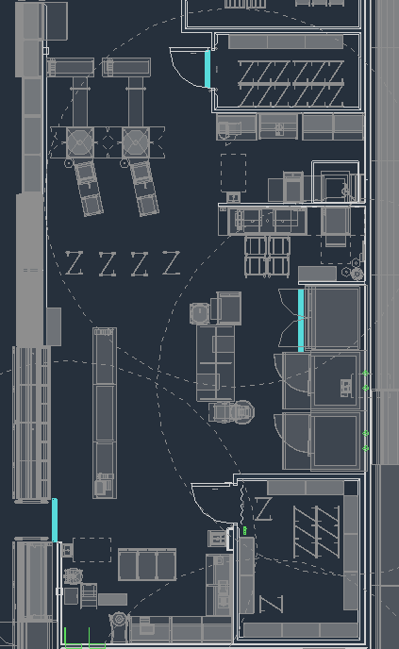
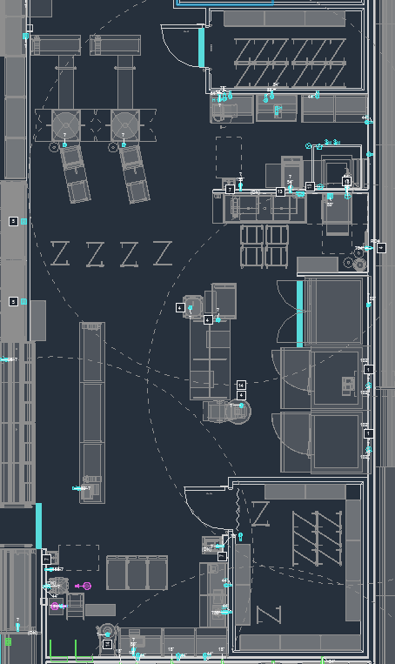
PROFILE PLACEMENT
From AutoCAD to Revit, in seconds.
Place from CAD or a linked Revit model: the engine matches every parent target to a captured profile, drops every linked element at its captured offset, and stamps the Element_Linker JSON for downstream audits and circuiting.
BEFORE - CAD layout (provided by architect)
AFTER - Revit equipment placed automatically

